Slide 1


Original
Ventures

Slide 2


Ventures
Sinan’s Design

Slide 3

Ventures
Sinan’s Design
This page has a video background. Play it!

Slide 4
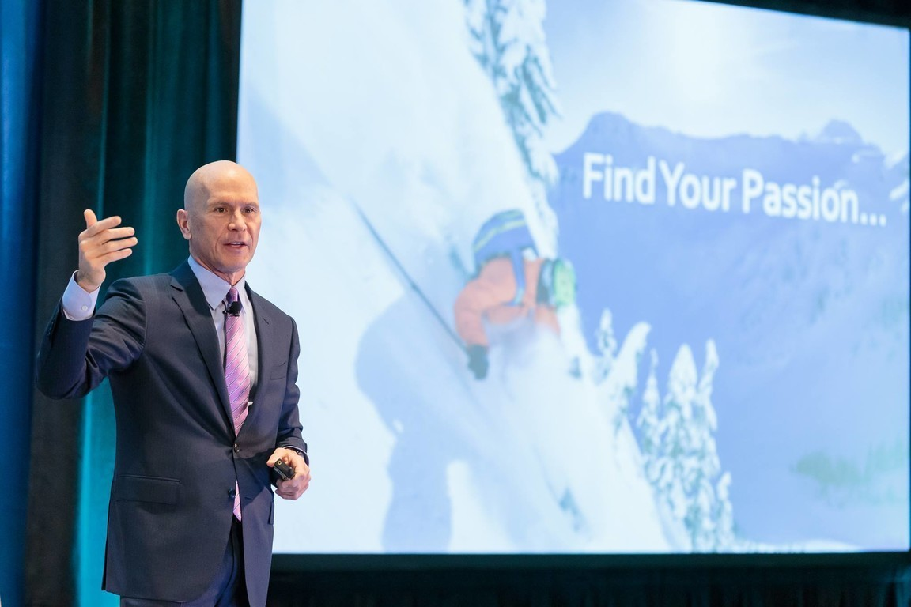
ABOUT THE HMG NETWORK
Original
Executive community of over 400,000 technology executives
International Advisory Board comprised of technology executives from Fortune 2000 organizations
Partnerships with today’s most innovative and cutting-edge technology companies
Over 30 renowned events around the world per year, featured in publications such as CIO.com’s Top Tech Conferences
Speakers and presentations that demonstrate the power of the network
Independent research and digital media platform
Over 30 years of experience and expertise as a premier relationship accelerator

Slide 5

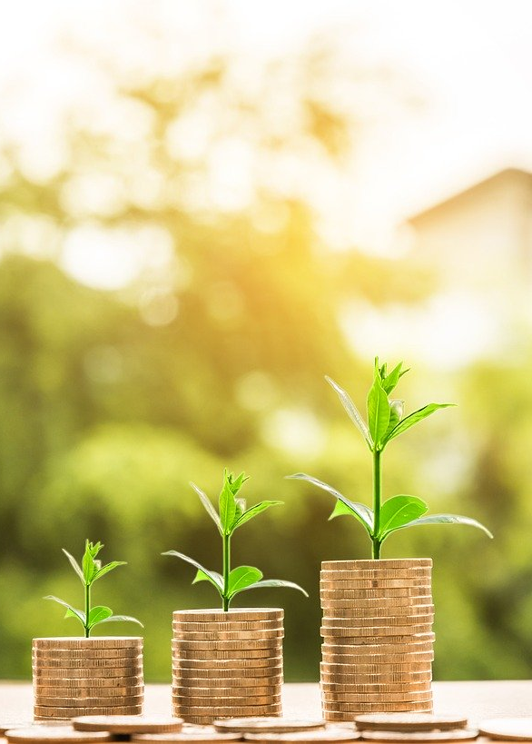
ABOUT THE HMG NETWORK
1. Executive community of over 400,000 technology executives
2. International Advisory Board comprised of technology executives from Fortune 2000 organizations
3. Partnerships with today’s most innovative and cutting-edge technology companies
4. Over 30 renowned events around the world per year, featured in publications such as CIO.com’s Top Tech Conferences
5. Speakers and presentations that demonstrate the power of the network
6. Independent research and digital media platform
7. Over 30 years of experience and expertise as a premier relationship accelerator
Sinan’s Design

Slide 6

ABOUT THE HMG NETWORK
400,000
2,000
30
Executive community of over 400,000 technology executives
International Advisory Board comprised of technology executives from Fortune 2000 organizations
Over 30 years of experience and expertise as a premier relationship accelerator
TOP TECH
POWER NETOWRK
INDEPENDENT
Over 30 renowned events around the world per year, featured in publications such as CIO.com’s Top Tech Conferences
Speakers and presentations that demonstrate the power of the network
Independent research and digital media platform
MOST INNOVATIVE
Partnerships with today’s most innovative and cutting-edge technology companies
Sinan’s Design

Slide 7
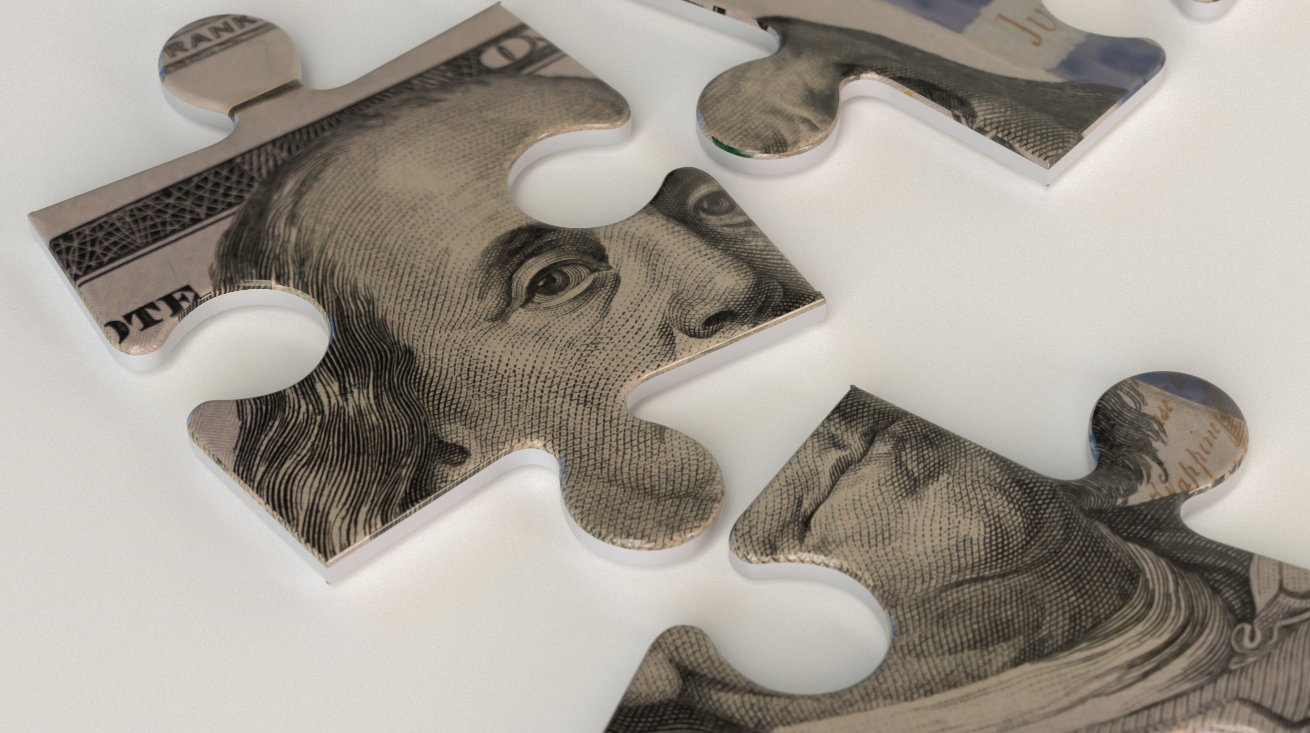
INVESTMENT PLATFORM
Original
High Deal flow from unique qualified channels
Hands-on vetting process with end-buyer centric feedback loop. Investment platform based on product validation and real-time performance of the companies
Co-Investments made with top tier VC’s and their teams.
Leveraging strategic investors insights, experience and connections. Our limited partners are current and former Global 2000 CEOs, CTOs, and CIOs with deep domain expertise.
Only HMG Ventures has access to HMG Strategy’s network and enterprise strategy dialog with weekly events around the world, providing unmatched access to talent, ideas, feedback, and funding.
Investing time and money to help portfolio companies learn to sell to large enterprises, refine their technology, and close early deals.

Slide 8
INVESTMENT PLATFORM
1
High Deal flow from unique qualified channels.
2
Hands-on vetting process with end-buyer centric feedback loop. Investment platform based on product validation and real-time performance of the companies.
3
Co-Investments made with top tier VC’s and their teams.
Leveraging strategic investors insights, experience and connections. Our limited partners are current and former Global 2000 CEOs, CTOs, and CIOs with deep domain expertise.
4
5
Only HMG Ventures has access to HMG Strategy’s network and enterprise strategy dialog with weekly events around the world, providing unmatched access to talent, ideas, feedback, and funding.
6
Investing time and money to help portfolio companies learn to sell to large enterprises, refine their technology, and close early deals.
Sinan’s Design

Slide 9
INVESTMENT PLATFORM
4. Leveraging strategic investors insights, experience and connections. Our limited partners are current and former Global 2000 CEOs, CTOs, and CIOs with deep domain expertise.
1. High Deal flow from unique qualified channels
5. Only HMG Ventures has access to HMG Strategy’s network and enterprise strategy dialog with weekly events around the world, providing unmatched access to talent, ideas, feedback, and funding.
2. Hands-on vetting process with end-buyer centric feedback loop. Investment platform based on product validation and real-time performance of the companies
6. Investing time and money to help portfolio companies learn to sell to large enterprises, refine their technology, and close early deals.
3. Co-Investments made with top tier VC’s and their teams.
Sinan’s Design

Slide 10
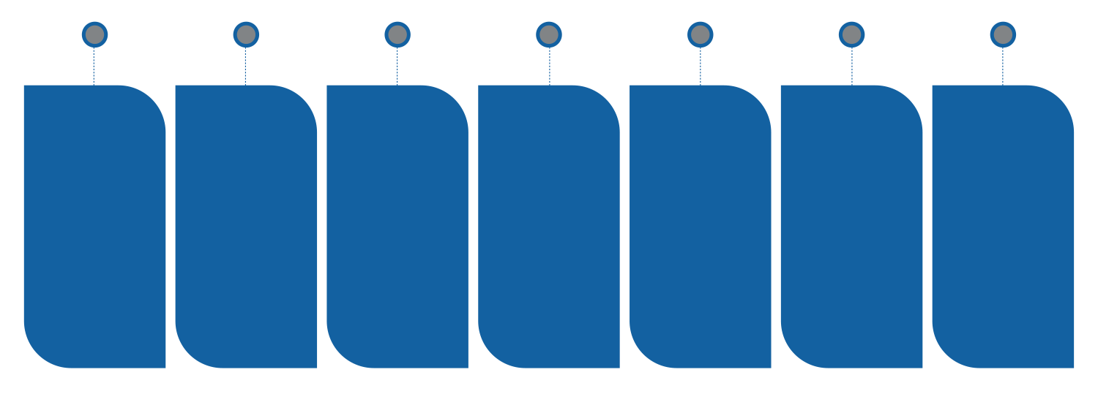
ADDING VALUE AT EACH STAGE
Original
STAGE 1
STAGE 2
STAGE 3
STAGE 4
STAGE 5
STAGE 6
STAGE 7
DEAL
FLOW
Founder introduction
VETTING
Investment criteria + analysis + instant network feedback
VALUE CREATION
Introduction for companies + see the new market utilization stories
INVESTMENT
Initial investment alongside
top-tier
VC partners
PROMOTION & GROW
Host promotional events + provide conference exposure + newsletters and referrals
MONITOR & REINVEST
Continuous analysis of customer feedback, performance breakaways occur, multiply investment allocation
STRATEGIC VALUE
Provide a great network to help companies after they have proven their product

Slide 11

ADDING VALUE AT EACH STAGE
STRATEGIC VALUE
Stage 7
MONITOR & REINVEST
Stage 6
PROMOTION & GROW
Stage 5
INVESTMENT
VALUE CREATION
Stage 4
DEAL FLOW
VETTING
Stage 3
Stage 1
Stage 2
Sinan’s Design

Slide 12

BUILT ON THE HMG NETWORK
Original
ADVISOR
PROGRAM
IDENTIFYING
Vetting to invest in the best 20-35 companies of 600+ that will come through our programs over the rest 3-4 years
Investment Pipeline & Scoreboard Process (Investment committee)
VENTURES PROGRAM
ACCELERATION
Helping promote and accelerate our investment companies and invest in 10-18 follow-on investments
Investment Financial Analysis
VENDOR
CERTIFICATION
INDUSTRY ANALYSIS
GLOBAL
NETWORK
STRATEGIC INVESTORS

Slide 13
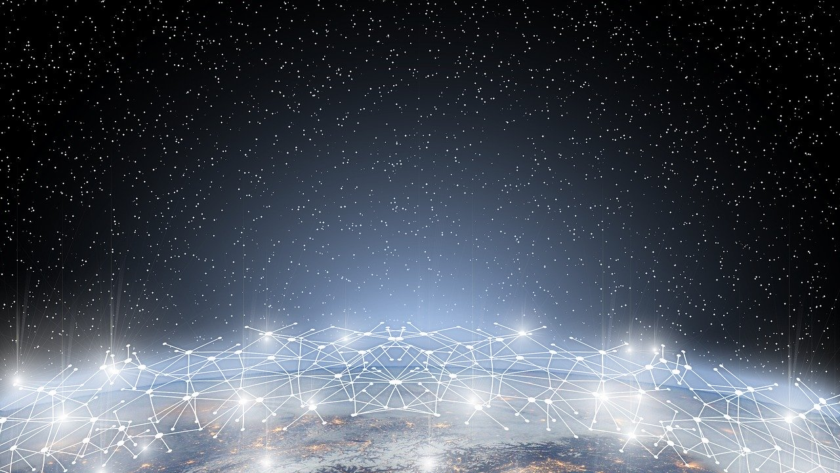
BULIT ON THE HMG NETWORK
VENTURES PROGRAM
ADVISOR PROGRAM
INDUSTRY ANALYSIS
VENDOR CERTIFICATION
STRATEGIC INVESTORS
GLOBAL NETWORK
Sinan’s Design

Slide 14

BUILT ON THE HMG NETWORK
IDENTIFYING
Vetting to invest in the best 20-35 companies of 600+ that will come through our programs over the rest 3-4 years
Investment Pipeline & Scoreboard Process (Investment committee)
ACCELERATION
Helping promote and accelerate our investment companies and invest in 10-18 follow-on investments
Investment Financial Analysis
Sinan’s Design

Slide 15
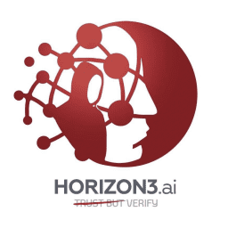
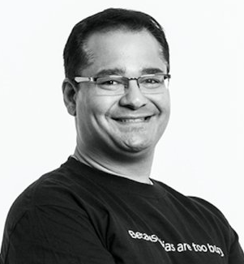

HORIZON3.ai CASE STUDY
Original
The opportunity
The company
The entrepreneur
Enterprise security: red-teaming as a service
Snehal Antani
JSOC | Splunk
The co-investors
The process
Why we won
Relationship cultivated by Hunter over years
Agile diligence and decision process
Domain expertise
Customer introductions

Slide 16


CASE STUDY
HORIZON3.ai CASE STUDY
The Opportunity
The Entrepreneur
Enterprise security: red-teaming as a service
Snehal Antani JSOC | Splunk
The Process
The Co-investors
Relationship cultivated by Hunter over years
Signal Fire
Why We Won
Agile diligence and decision process
Domain expertise
Customer introductions
Sinan’s Design

Slide 17
CASE STUDY
THE OPPORTUNITY
THE COMPANY
THE ENTREPRENEUR
Enterprise security:
red-teaming as a service
Snehal Antani
JSOC | Splunk
THE CO-INVESTORS
THE PROCESS
WHY WE WON
Relationship cultivated by Hunter over years
Agile diligence and decision process
Domain expertise
Customer introductions
Sinan’s Design

Slide 18
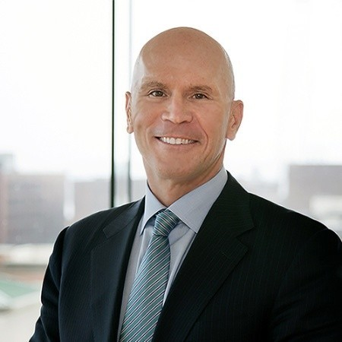
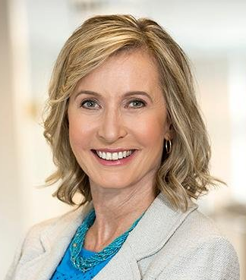
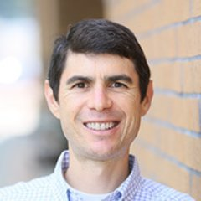
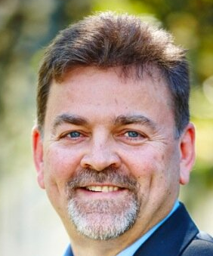
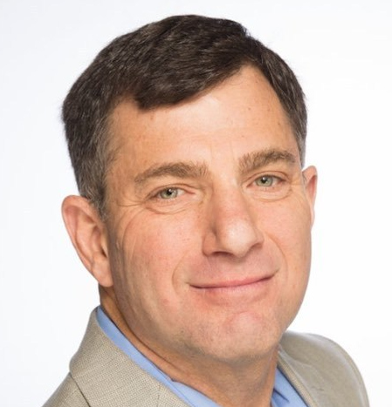
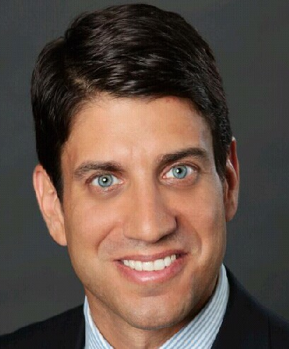
THE TEAM
Original
Hunter Muller
Patty Hatter
Dan Turchin
Ralph Loura
Steve Kaplan
George Maddaloni

Slide 19

THE TEAM
Hunter Muller
Patty Hatter
Dan Turchin
Ralph Loura
Steve Kaplan
George Maddaloni
Sinan’s Design

Slide 20
FUND MECHANICS
Original
Fund I target size
Fund status
Investment stage
Investments
Investment size
Fee structure
Geographic focus
$5m; minimum investment: $100k
Commitment of $1m to date
Seed
Target 20 investments in maiden fund, four investments per year
Most initial will be from $200-300k; additional funds will be reserved for follow-on
2% management fee and 20% management carry after LP distribution
U.S.

Slide 21
FUND MECHANICS
Fund I Target Size
$5m; minimum investment: $100k
Fund Status
Commitment of $1m to date
Investment stage
Seed
Investments
Target 20 investments in maiden fund, four investments per year
Investment Size
Most initial will be from $200-300k; additional funds will be reserved for follow-on
Fee Structure
2% management fee and 20% management carry after LP distribution
Geographic Focus
U.S.
Sinan’s Design

Slide 22

FUND TIMETABLE
Original
May 2020: initial investments made
August 2021: fund formation
October 2021: fund announcement
Q1 2022: first close of fund I
Q2 2022: final close of fund I
Q4 2022 begin raising fund II

Slide 23

FUND TIMETABLE
Begin Raising Fund II
Q4 2022
Final Close Of Fund I
Q2 2022
First Close Of Fund I
Fund Announcement
October 2021
Q1 2022
Fund Formation
August 2021
Initial Investments Made
May 2020
Sinan’s Design

Slide 24

T
H
A
N
K
S
Sinan’s Design

Slide 25

THANKS
Sinan’s Design

